Slide 1
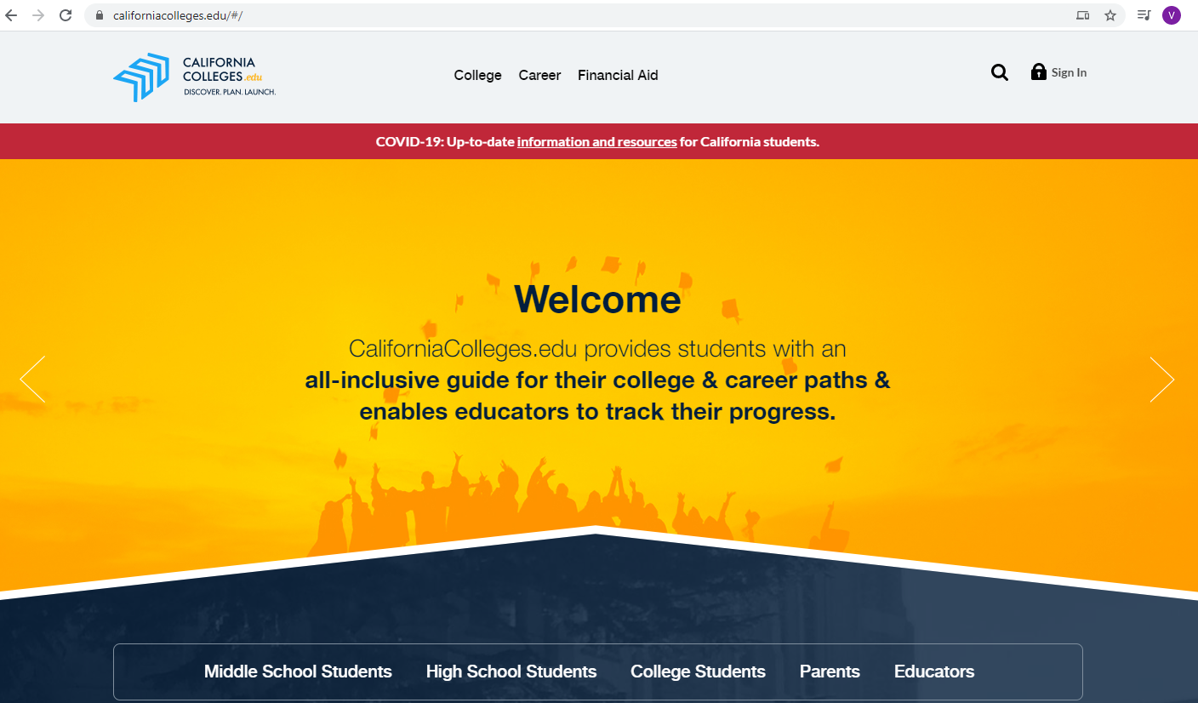
Navigating California Colleges
CCGI

Slide 2
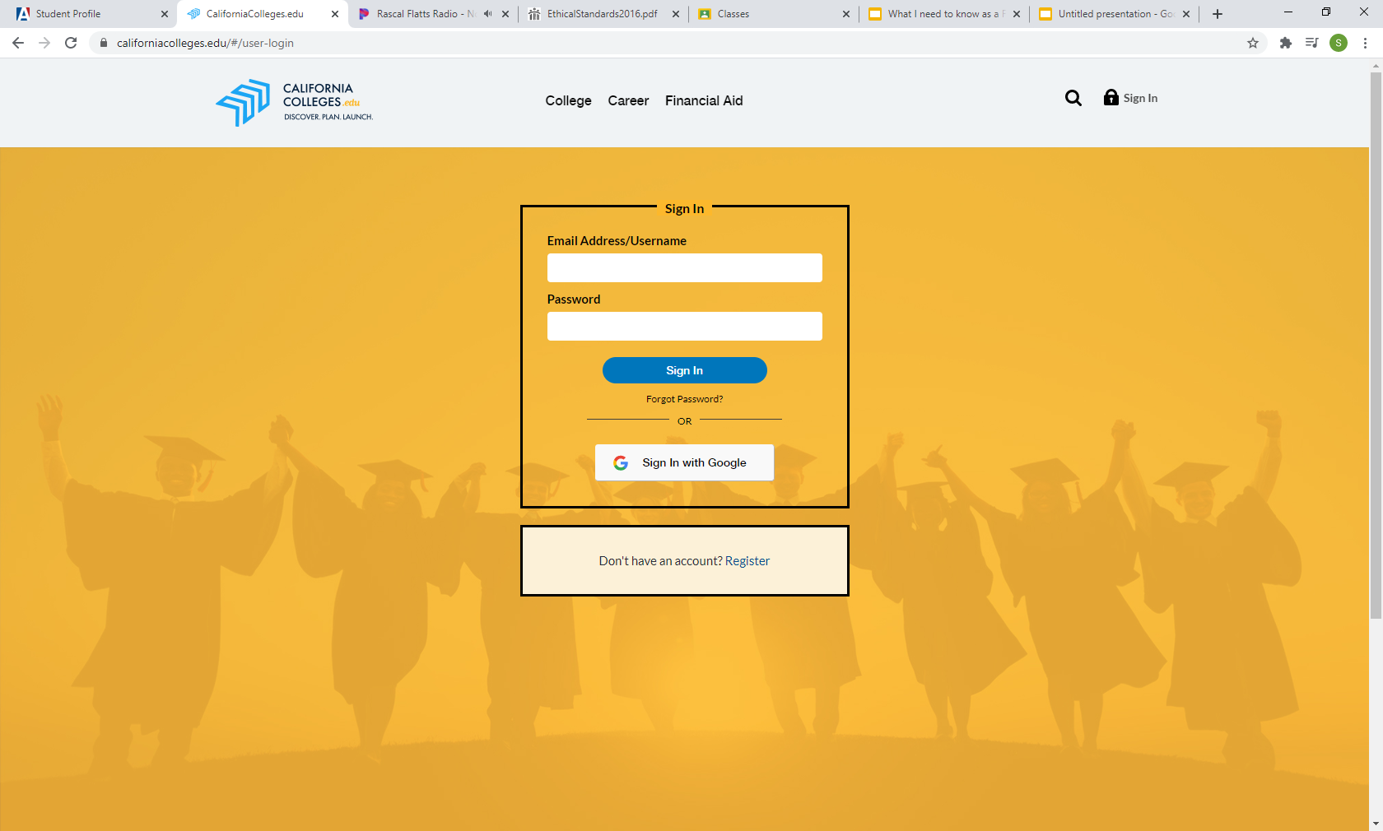
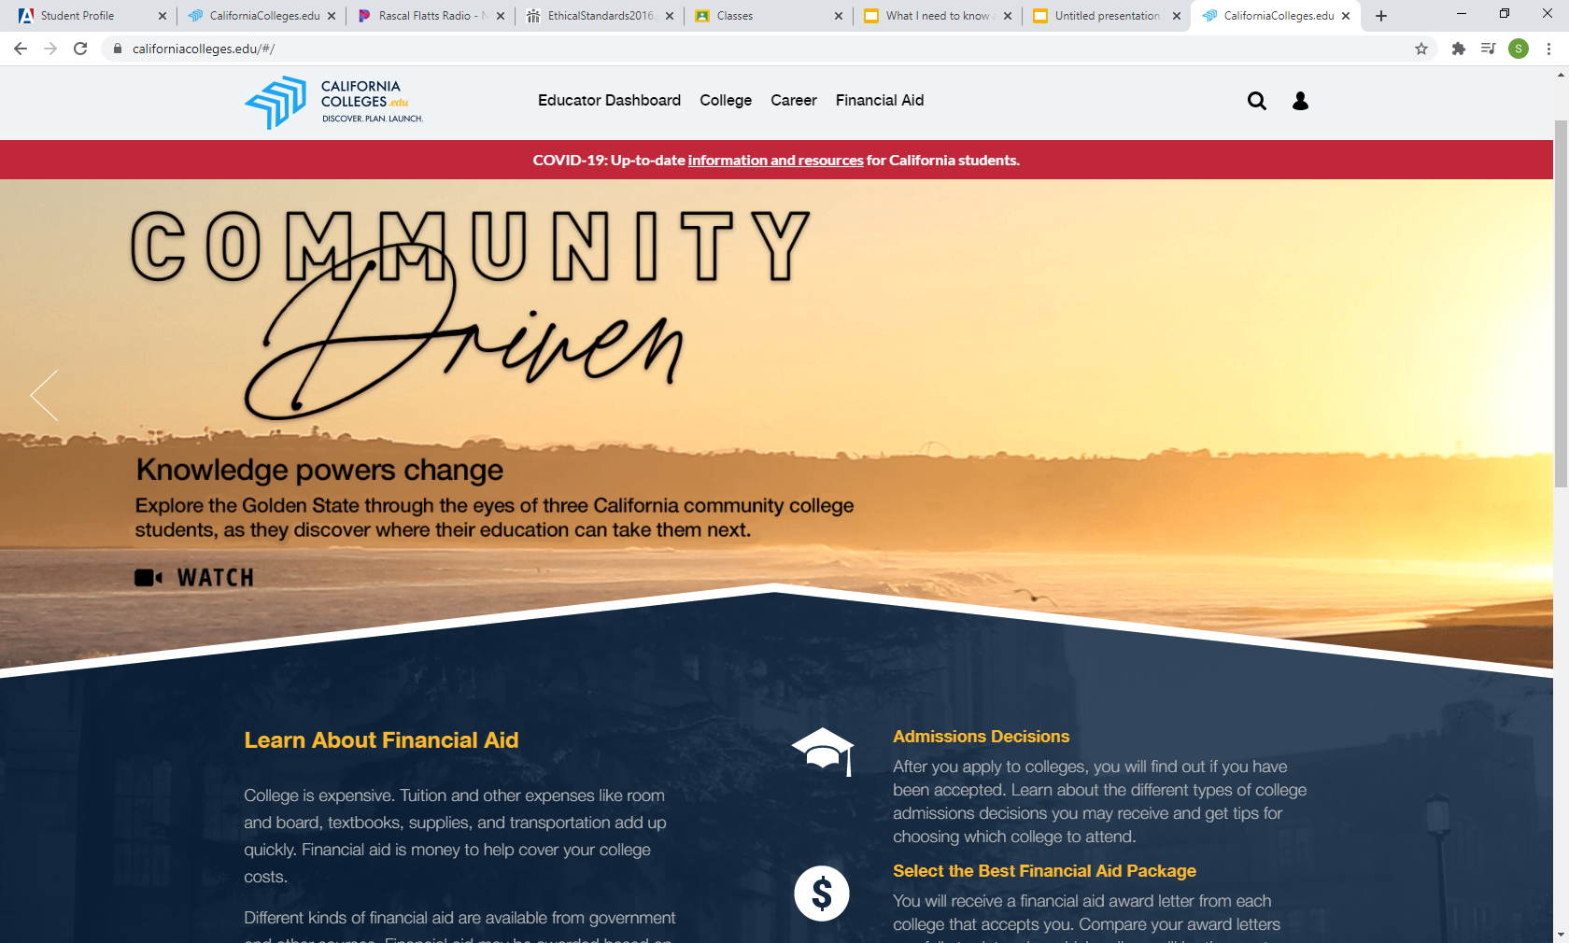
Getting Connected
Log on to CCGI account
User name is your student email
Password is your Id number

Slide 3
Know what your plan is!
Go to the Career tab
Go to Interest profiler Assessment
Work Values
Multiple Intelligences
Do what you are
Notes:
You might have already done this assessment last year and if you have you can skip this step. But this assessment will ask you questions about different tasks and you will have to rate how much you like doing this tasks on a scale. The results that you get will tell you what careers people who are LIKE you are HAPPY in.

Slide 4
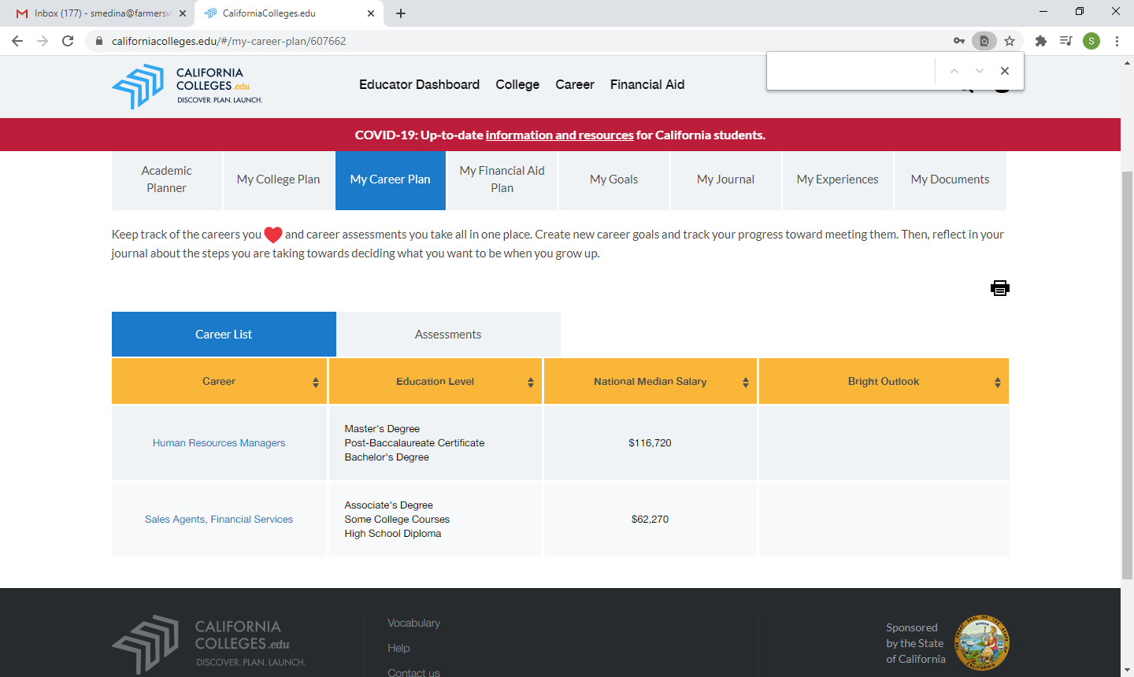
Career Results
You will then get career results
Education Level needed
Average income
Notes:
These Results are a great start to looking into different careers and Schools that offer Certificates/ Degrees to practice these careers/jobs.
Some of you will get several pages worth of results and others will only get a few recommendations.
If you don’t agree with any of your career results there's other career inventory quizzes you can take. (Caeer Zone. Career Coach)

Slide 5
How Can I look into the Majors I am Interested in
Use this tool to help you discover Majors that interest you
Find Colleges that offer them
Learn more about what they involve
Acceptance rate for colleges and total enrollment
Cost and Financial aid

Slide 6
Use the College Search Tool
Helps you find the college in California and across the country based on the factors that matter most to you.
Search by:
Field of study
Program
Major
State
Specialty schools
Campus Activities
Teams and sports

Slide 7
Using the Academic Planner
Review completed courses and grades.
Planning future course work.
Make sure you are on track to achieve your goals.

Slide 8
Use the CSU and UC Eligible Tools
Allows you to track you progress for UC and CSU eligibility.
Identify areas you need to work on.
Catch any issues while you still have time to work on it.

Slide 9
Graduation Requirements
English- 4 years = 40 credits
Math - 2 years = 20 credits
Algebra- 1 year = 10 credits
Life Science- 1 year =10 credits
Physical Science- 1 year = 10 credits
Freshman Studies- 1 year = 10 credits
World History - 1 year = 10 credits
Total= 250 credits
US History - 1 year = 10 credits
Government - ½ year = 5 credits
Economics - ½ year = 5 credits
Physical Education - 2 years = 2- credits
CTE/ Fine ART For Lan - 1 year = 10 credits
Electives = 90 credits

Slide 10
Using My Goal Tools
Helps keep you on track by helping you identify, set and monitor your academic and career goals.

Slide 11
My Journal Tool
Gives you a place to reflect about your past make connections to the present and plan for the future.

Slide 12
Contact your Counselor
Last Name A-L: Mrs. Maciel- Gomes
Email:vgomes@farmersville.k12.ca.us or vgomes@farmersville.net
Google Phone 1-559-679-3539; Remind App Info: Text to: 81010, in the message type: @fhsgomes
Last Name M-Z: Mrs.Medina
Email: smedina@farmersville.k12.ca.us or smedina@farmersville.net
Google Phone 1-920-322-5970 Remind App Info: Text to: 81010, in the message type: @h78ka8

